Slide 1
[School/District Name]
WIN Work Readiness Assessments Test Administration Training

Slide 2
How to Use This Template
Insert your school/district’s logo, PowerPoint theme, if desired. If you choose not to add logo or text in the provided boxes, it will not show up in the slide show.
Modify this template based on the needs of your school and/or district.
All areas to be modified are indicated with purple text. Other text can be modified as needed; however, all content should be addressed in training.
Add/delete sections or slides as necessary for your school or district.

Slide 3
People to Know

Slide 4
People to Know 3
[Name], Building Assessment Coordinator​
  If you have any questions about test administration, test policies and procedures, or if there are any testing irregularities​
  [Insert contact information]​
[Name], Principal​
  If you have questions regarding test administration scheduling, policies, or if there are any concerns regarding unethical behavior by staff.​
  [Insert contact information]​

Slide 5
People to Know 2
[Name], Technology Coordinator​
  If you have any technology questions before or during test administration ​
  [Insert contact information]​
[Name], District Assessment Coordinator​
  If you are unable to contact your Building Assessment Coordinator​
  [Insert contact information]​

Slide 6
People to Know 4
OEAA Tip Line
  Contact the OEAA tip line to directly report suspected unethical behavior
  1-877-560-8378, Option 1

Slide 7
About WIN Work Readiness Assessments
Part of the Michigan Merit Exam (MME)
Three components, each 60 minutes, all multiple choice:
  Work Ready Math (calculator allowed)
  Work Ready Reading (no calculator)
  Work Ready Data (no calculator)
Credential level (2–5) determined by the LOWEST score across all three
Testing window: April 6 – May 1, 2026
Staff and students log in at mi.wincrsystem.com (no “www”)
Respondus® Lockdown Browser required on all student devices before test day

Slide 8
How WIN Testing Works
Before test day (BAC — or TA if assigned by BAC):
  Accommodations assigned in WIN Career Readiness System (CRS);
  test sessions created; test tickets generated
On test day — Test Administrators (you):
  Log in to WIN CRS → Assessment Assignment Grid → pull students in
  Verify accommodations → read script→ distribute test tickets
  Click Apply Changes to unlock the test → monitor students
  Collect all materials when done → return to BAC immediately
Students:
  Log in at mi.wincrsystem.com with test ticket credentials
  Complete tutorials (optional), then take each component at TA direction
  Can view scores and credentials after all three components are submitted

Slide 9
WIN Test Components & Timing
Work Ready Math - 60 minutes (calculator allowed - embedded scientific calculator online)
Work Ready Reading - 60 minutes (no calculator)
Work Ready Data - 60 minutes (no calculator)
Total testing time: 3 hours
Breaks: Optional between components

Slide 10
WIN Features & Supports
Standard Tools — available to ALL students, no accommodation needed:
  Calculator (Math only), color overlay, highlighting, magnification,
  line reader, scratch paper, formula sheet (Math), timer, repeated directions
Embedded Accommodations — require IEP, 504, or EL designation:
  SpeechStream® (text-to-speech), Extended Time (1.5x or 2x), ASL (embedded video), Spanish (translated form)
Scores & Credentials:
  Students see scores only after all three components are submitted
  Credential level appears on student dashboard and can be downloaded
  If students choose to provide email in WIN CRS, digital credentials can be shared on social media, resumes, email

Slide 11
Before Testing

Slide 12
Test Administrator To-Do List - Before Test Day
Review the Online Test Administration Manual (TAM)
Complete MDE Assessment Security training
Read the Assessment Security for Test Administrators document
or
Complete Michigan Virtual modules
Sign the OEAA Security Compliance Form — do this today during training
Confirm your WIN CRS login — log in to mi.wincrsystem.com and verify credentials work
Save BAC contact info + WIN Support: 888-717-9461 Option 2

Slide 13
WIN Testing Clarifications
WIN is an online assessment (paper available based on student need)
Each component is timed: 60 minutes
Breaks between components are optional, not required
Components can be given in any order and on different days within the window
Test Administrators read a script before each component
All testing is completed on school days within the test administration window: April 6 – May 1, 2026
Test Administrators cannot administer the test to their own relatives; contact your Building Assessment Coordinator if you have a relative assigned to your test sessions.

Slide 14
Materials You Will Receive from Your BAC
Test Tickets — one per student; secure item; never leave unattended
Student Roster — list of students in your session; also secure
Accommodations List — which students have IEP/504 accommodations
Test Administration Script — word-for-word directions to read aloud
Word-to-word dictionary — paper only; for EL students
Headphones — for students using SpeechStream®
[If anything is missing, contact BAC: name/contact here]

Slide 15
Test Administration Schedule
[Insert your building/district testing schedule here]​

Slide 16
The Test Administration Script
You MUST read the testing script word for word before each component
Scripts are in the TAM (page 47) and on the WIN Resource Page
The script covers:
  Testing Rules, Login, Tutorials, Test Information, Starting the Test, After Each Test, After Final Assessment
Rules for script delivery:
  Do not paraphrase, summarize, or skip sections
  Read [SAY:] sections exactly as written
  You may ONLY answer questions about directions — NEVER about test content

Slide 17
Accommodations - Your Role Before Test Day
[Include information about how Test Administrators are aware of, monitor,
and are give access to accommodations materials, as needed]
Notes:
day.

Slide 18
WIN Standard Tools and Features
Standard Tools available to ALL students:
Online/personal calculators (Work Ready Math only)
Color overlay & highlighting
Magnification & zoom
Scratch paper (must be collected and shredded)
Formula sheet (Math only - embedded)
Timer display, Line reader, Repeated directions, Individual administration

Slide 19
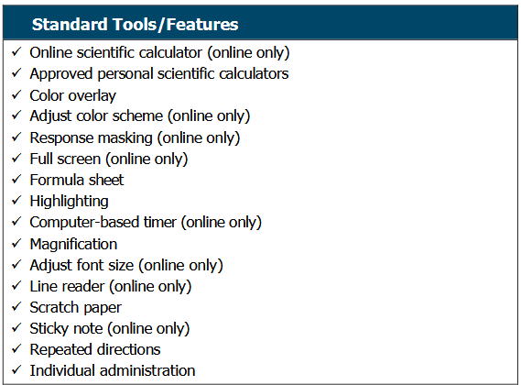
WIN Standard Tools and Features - Continued

Slide 20
WIN Accommodations (Embedded)
WIN accommodations are embedded in the online testing system and assigned by Building/District Assessment Coordinator:
SpeechStream® (text-to-speech for oral administration)
Extended Time (1.5x or 2x)
American Sign Language (ASL)
Spanish Testing
All accommodations require IEP or 504 plan (Spanish can be assigned for EL needs without IEP/504)
Notes:
.

Slide 21
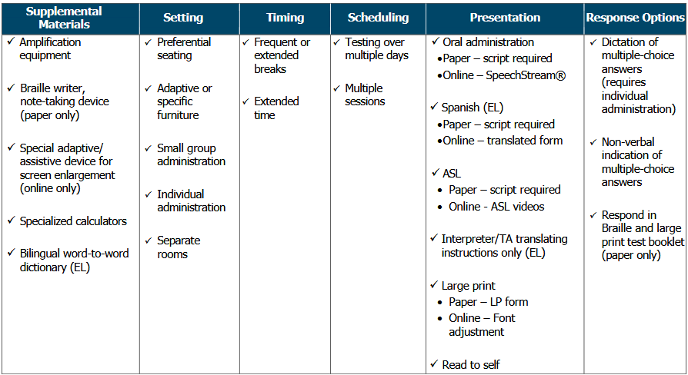
WIN Accommodations

Slide 22
Secure Materials - Handle With Care
Secure materials for online testing:
  Test tickets and student rosters
  Used scratch paper (any paper with student markings)
Rules for ALL secure materials:
  Never leave unattended; distribute tickets individually
  Count before AND after each session
  Return ALL materials to BAC immediately after each session
  Used scratch paper must be SHREDDED — not recycled or trashed
[Insert building chain-of-custody procedure here]

Slide 23
Managing Test Materials - During the Session
Student finishes testing:
  Collect ticket, scratch paper, calculator immediately
Student needs extended time:
  Do not rush; collect all materials when they finish
Student started but did not finish in one session:
  Collect test ticket but do not destroy — student needs it to log back in
Student is absent:
  Hold ticket securely; return to BAC at end of day; do not give to anyone else
There is NO unlock option in WIN — accidental submit = retake only, all answers deleted. This requires an Incident Report to be submitted in the OEAA Secure Site
[Insert local policy for Test Administrators if an Incident Report is necessary]

Slide 24
Managing Materials - Extended Time Students
Extended time students must be provided with their assigned extended
accommodation if needed
Plan for the room to be available for the full extended period
Do not hint to students that time is almost up — the system enforces the limit
Students may submit early if finished; they do not have to use all time
If all extended-time students finish early, TA may assign the next assessment
[PURPLE: Insert building/district guidance for extended time room assignment and scheduling]

Slide 25
Cell Phone & Electronic Device Policy
Students — prohibited behavior:
  Having any electronic device accessible during testing (on desk, in
  pocket, within reach)
  Important: accessed = prohibited behavior; using the device may result in test invalidation
  The no-device rule applies until the session is fully closed, even after submitting
Staff — required:
  Silence your devices; no checking email or phone during a session
[Insert building/district policy — where or how students store devices during testing]

Slide 26
Calculator Policy
Calculators ONLY for Work Ready Math — NOT for Reading or Data
Online testing: embedded scientific calculator is built into the system
If providing physical calculators:
  Scientific calculators only
  Calculators that automatically calculate unit conversions are NOT permitted
  All calculators with memory must be cleared BEFORE and AFTER testing
Students with visual impairments:
  May use specialized calculators (e.g., Orion TI-30XS Talking Calculator) per IEP/504
  Talking calculators must be used with headphones or during individual administration

Slide 27
Scratch Paper Policy
Scratch paper is optional
If provided: distribute when distributing test tickets
Have students write their name on scratch paper immediately
Collect ALL scratch paper from every student at end of each component
Used scratch paper is a SECURE material — must be SHREDDED
Do not recycle, trash, or take home to shred later
[Provide information about where and how to access scratch paper, and local secure material handling procedures]

Slide 28
The Respondus Lockdown Browser
WIN Work Readiness does not have a test application; students log in
to the WIN CRS with test ticket login information
Open browser → mi.wincrsystem.com → TA instructs students and students launch the assessment → “Assessment is opening in locked browser...” → test loads
If it will not launch:
  Click Yes to close other programs → wait for “Opening Assessment” → Start
  Chromebook “Chrome OS can’t open this page” = extension not installed → call Tech Coordinator
  Other devices not launching = browser not installed correctly → call Tech Coordinator
  If still unresolved → WIN Support: 888-717-9461 Option 2
Do NOT bypass the lockdown browser— security violation

Slide 29
WIN Assessment Tutorials
Tutorials let students practice the testing interface — not scored
Accessed using test ticket credentials at mi.wincrsystem.com
Demo videos available at: https://fast.wistia.com/embed/channel/wkgohqdi0v
Available in English and Spanish; ASL students assigned ASL tutorials
Tutorials available: Navigation (~5 min) + each component (~5 min each)
Best practice — arrange before test day:
  Show to whole class; model standard tools; let students practice on their actual testing device
If tutorials have not been done before test day:
  Allow ~10 extra minutes; script includes directions for running tutorials on test day
  [This task can be completed on test day, or before test day. Insert local policy.]

Slide 30
Preparing the Testing Environment
Before students arrive, verify:
  Seating: enough space between students that no one can view screens
  Walls: all instructional materials removed or covered (word walls, formulas, test-taking tips)
  Devices: all computers on and Lockdown Browser tested, charging cords as needed
  Post a “Testing in Progress — Do Not Disturb” sign
  Coordinate with office: no intercom announcements during sessions if possible
Only trained testing staff in the room — no parents, volunteers, other staff, media
Non-authorized person in room = testing irregularity requiring incident report
[Insert building-specific room setup requirements]

Slide 31
If You Have Additional Staff During Testing
WIN has no required TA-to-student ratio; WIN recommends 1:30 ratio.
There must be enough staff to actively monitor ALL students throughout
the session
All staff in the room must be trained in WIN test administration policies
Give additional staff clear roles before the session:
  Walk a different section of the room
  Distribute and collect materials
  Support students using accommodations
  For dictation accommodation: requires TWO trained staff (one admin, one scribe)
[Insert building guidance for proctor roles and assignments]

Slide 32
Who is allowed in the room during testing
Only Test Administrators and staff who are trained in the administration policies and procedures for the assessment being administered are allowed in the testing room during testing.
  Parents, volunteers, other staff members, media, and any other community members are NOT allowed in the test room during testing for any reason, even to support students with behavioral needs.
  If any non-authorized person is in the room during testing this is a test irregularity and requires an incident report to be submitted to the MDE Office of Educational Assessment and Accountability (OEAA) for review.

Slide 33
Test Administrator Test Day Tasks in the WIN Career Readiness System

Slide 34
Test Day: Logging into WIN CRS
On test day, Test Administrators will:
1. Log in to WIN Career Readiness System at mi.wincrsystem.com
2. Navigate to Assessment Assignment Grid
3. Select test session group(s) to pull students into grid
4. Verify all students are in grid with correct accommodations
5. Select "Apply Changes" when students are ready to begin

Slide 35
Test Day: Logging into WIN CRS - Continued
Step-by-step instructions and screenshots are also available in “Appendix D – Test Administrator Testing Duties” (page 40) in the Online Test Administration Manual

Slide 36
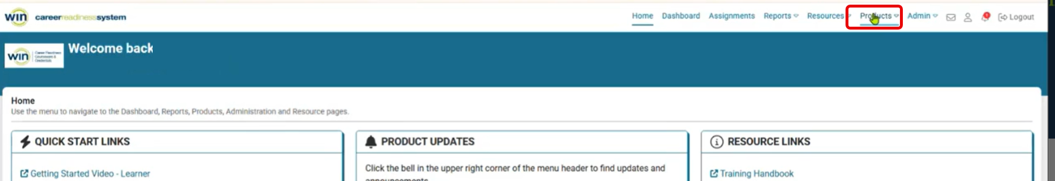
Accessing your Test Session Group(s)
Go to the Products dropdown – Select Work Readiness Assessments

Slide 37
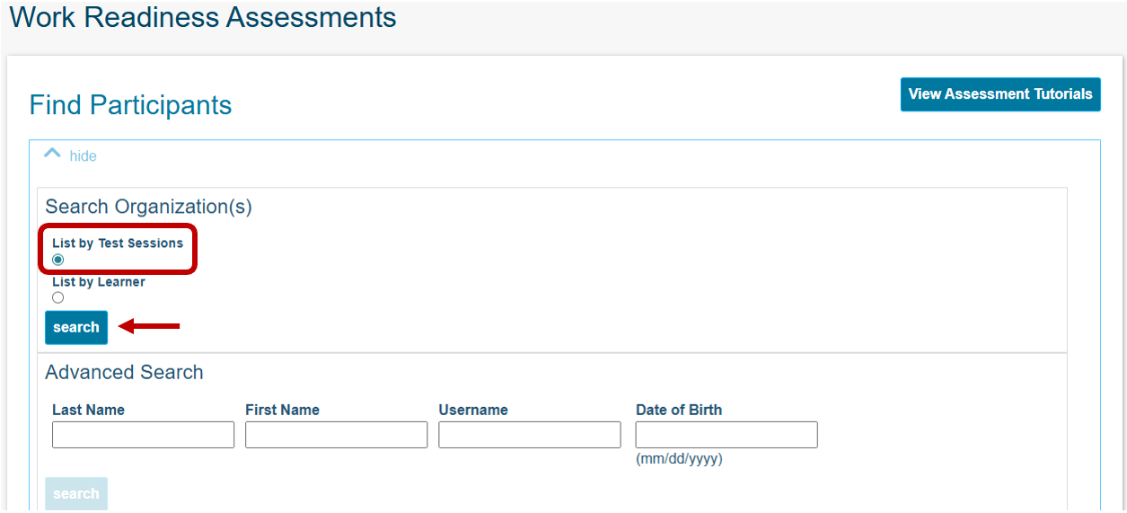
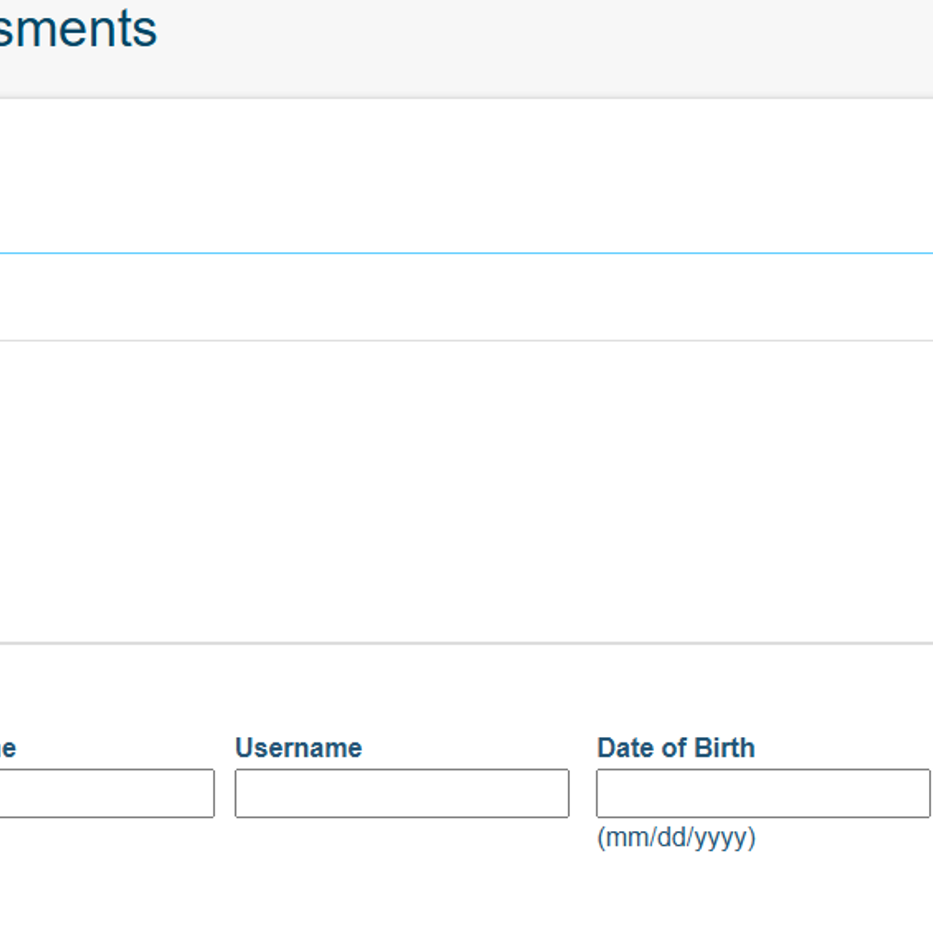
Search “List by Test Session”

Slide 38
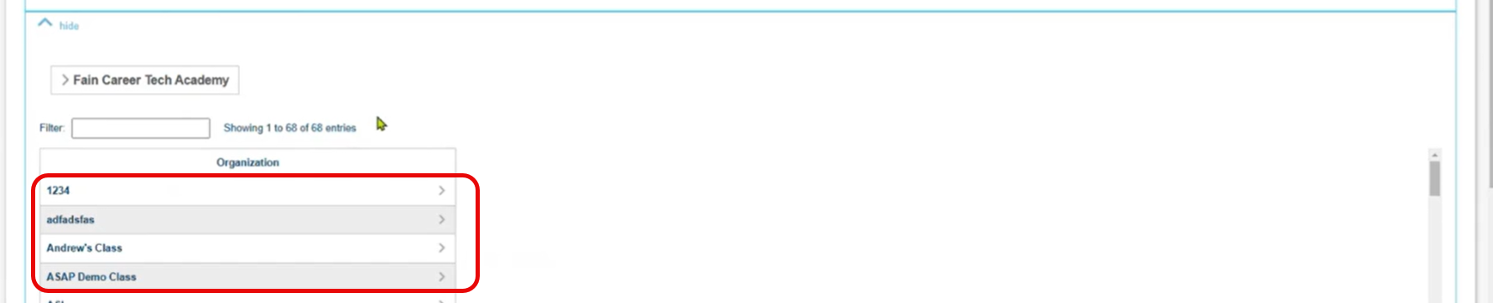
Select your assigned test session
Scroll down after you select Search to find your assigned test sessions:

Slide 39
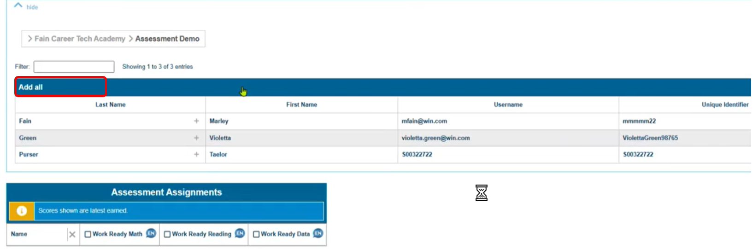
View Students
When you select your class, you will be able to see students
in your test session, select Add all to pull students into the Assessment Assignment Grid

Slide 40
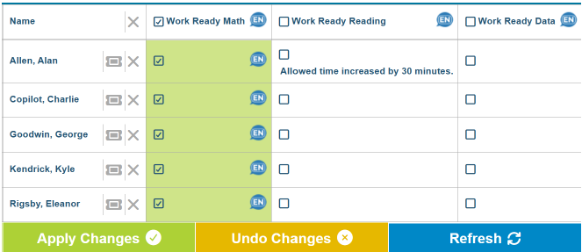
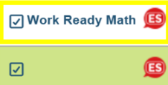
WIN CRS: Assessment Assignment Grid
• Shows all students in test session
• Select checkbox next to component (Math/Reading/Data) to assign
• If testing in Spanish, select the language bubble (EN) for the individual or group, and select (ES). It is recommended to test all Spanish together.
STOP HERE. Do not select Apply Changes until you are ready for the students to begin the test.

Slide 41
Test Day - Step by Step: Launch to Go
1. Read Testing Rules from script — word for word
2. Confirm all electronic devices are stored away
3. Distribute test tickets individually; verify each student’s name
4. Distribute scratch paper (if provided) — students write name immediately
5. Students log in to mi.wincrsystem.com → GO on Work Readiness Assessments
6. Run tutorials if not previously completed (~10 min)
7. Read Test Information section of script
8. STOP — verify all students are logged in and ready
9. Click Apply Changes — timer starts, test is now LIVE
10. Students click the arrow next to assessment name to begin

Slide 42
Student View on Test Day

Slide 43
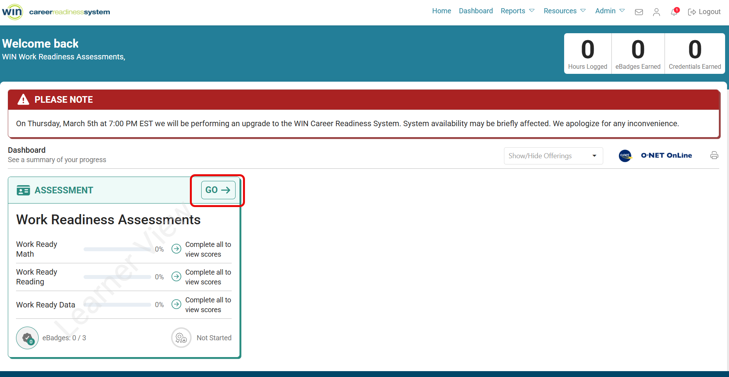
Student View: Login
When students log in to WIN CRS with their test tickets they will see the Assessment tile. They must select Go in the upper right corner of the tile

Slide 44
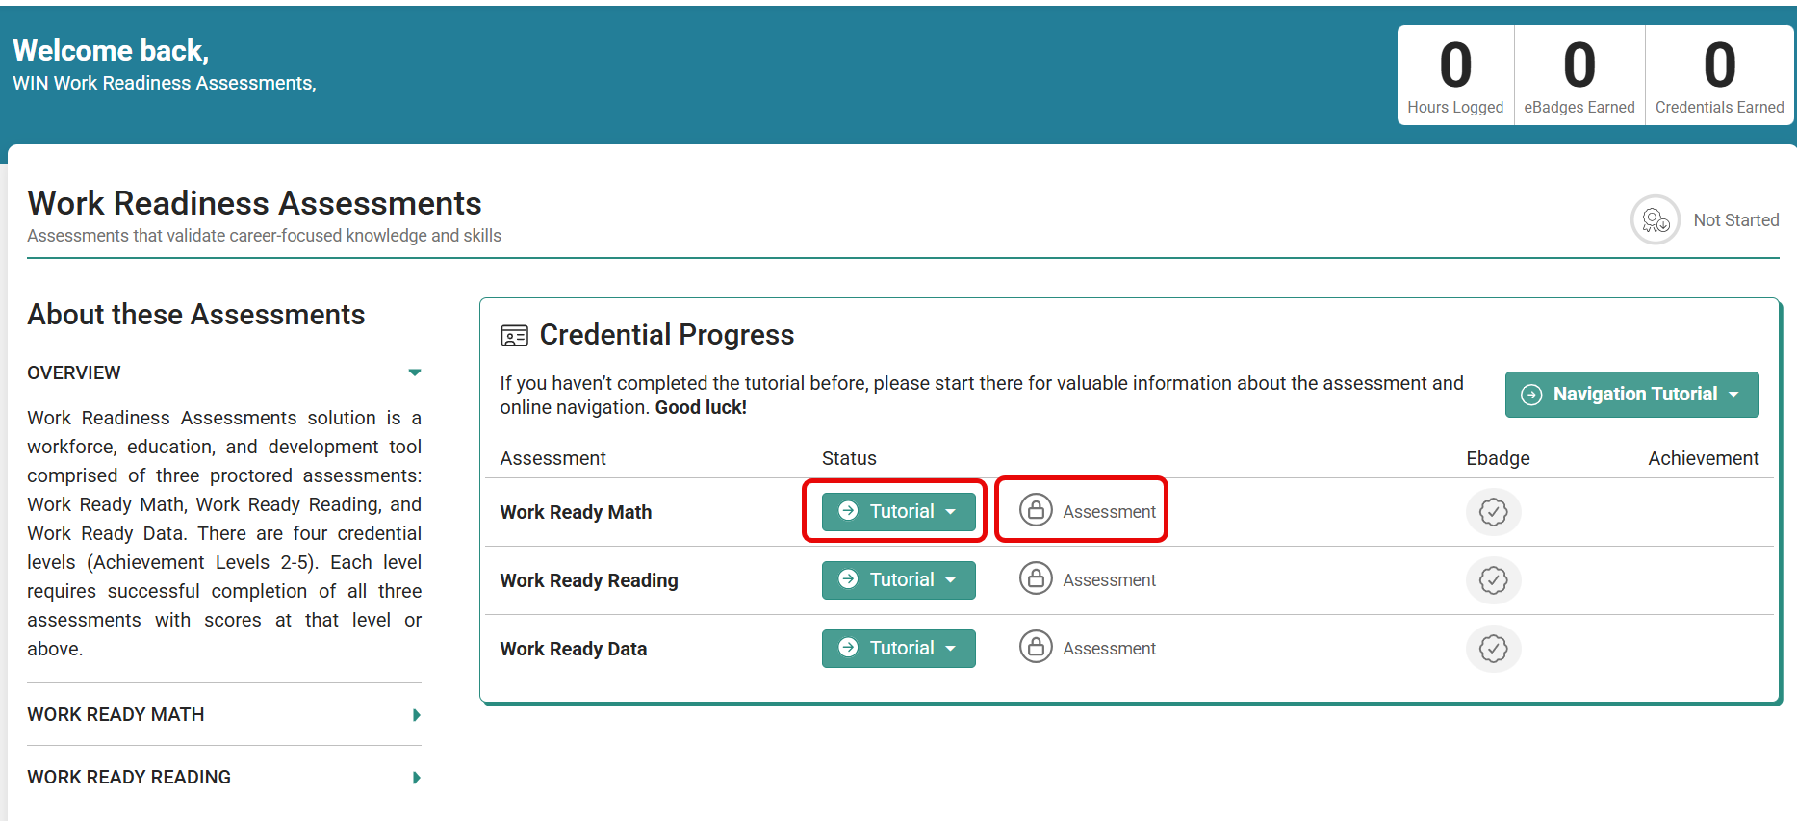
Accessing Tutorials and the Assessments
When students select Go, they will see the assessment page.

Slide 45
Student Assessment Page
When students view the assessment page, you can:
Instruct them to select Tutorial for each assessment to view the tutorials
  Tutorials are available in English and Spanish
Read the script, pull students into the Assessment Assignment Grid (if not already), select Apply Changes, and instruct them to begin testing

Slide 46
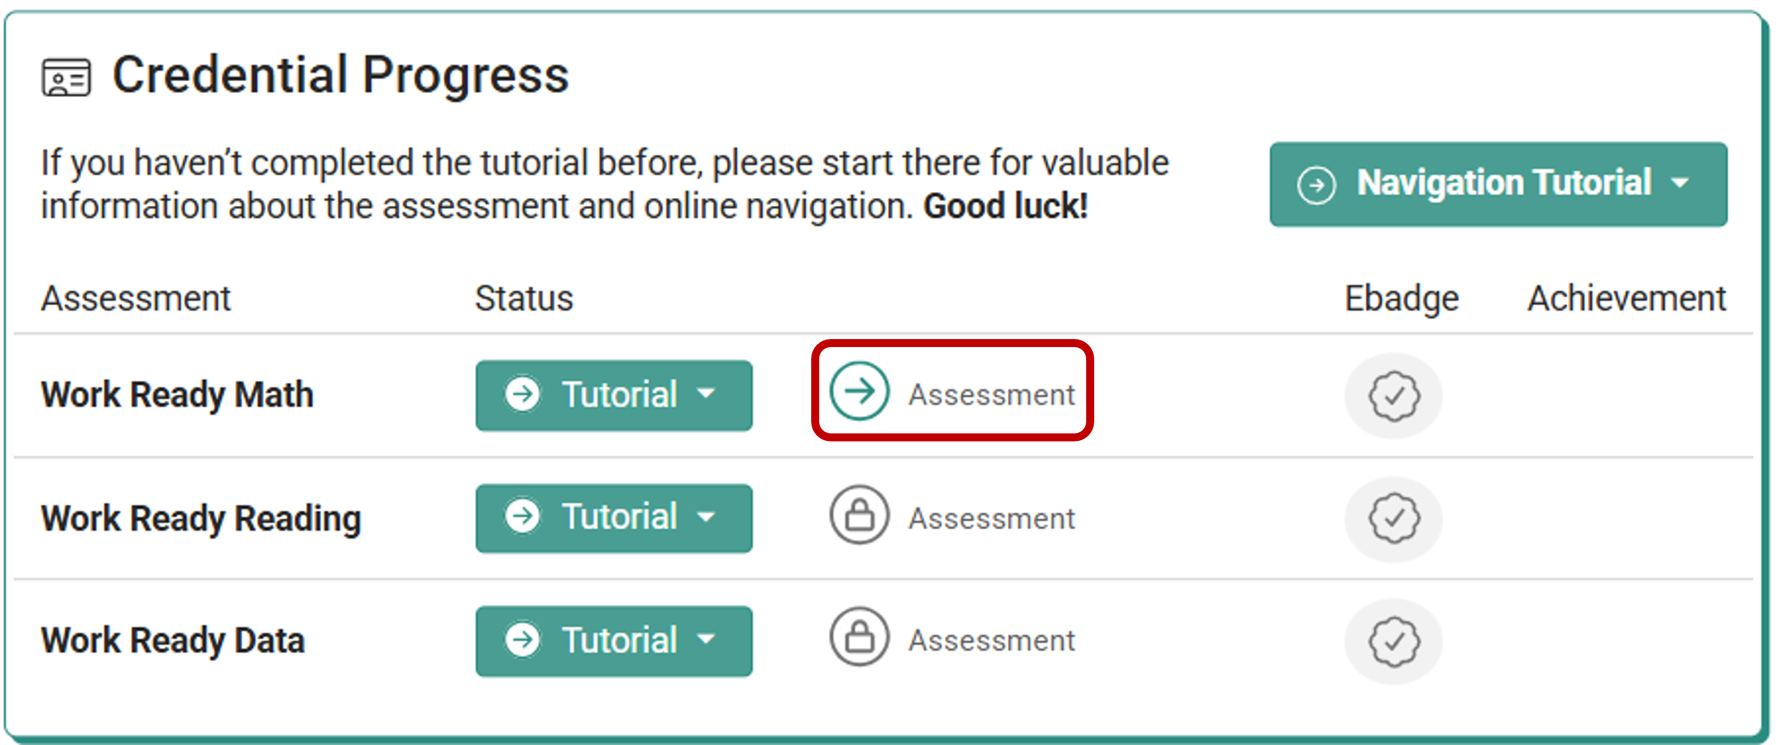
Student Assessment Page on Test Day
On test day, after you have pulled students into the
Assessment Assignment Grid, selected an assessment, and
selected Apply Changes, the student assessment page will update the lock image to a green arrow, allowing students to access the assessment

Slide 47
During Testing

Slide 48
Large Group Testing (>30 Students) [OPTIONAL]
If testing more than 30 students in one session:
• Monitoring Tool may be significantly delayed or unavailable
• Pause feature is only available in the monitoring tool, students do not have a pause button
• If student needs to step away: Student must exit from browser (work is auto-saved, timer stops)
Note: Be sure students do not submit the test; only exit the browser
• Student will need test ticket to log back in
Recommendation: Keep test session groups to 30 or fewer students when possible, for best monitoring tool functionality
[Building/District Coordinators: Include or delete this slide based on your test session sizes]

Slide 49
Active Monitoring & Test Session Management
During testing:
• Monitor students actively in the classroom
• Optional: Use Monitoring Tool to view student progress (≤30 students)
• Do not use Monitoring Tool unnecessarily - focus on in-person monitoring
After each component:
• Collect test tickets and scratch paper
• Allow optional break between components
• Redistribute materials for next component

Slide 50
Active Monitoring of Students​
Frequently move through the room and monitor students’ work area​
Full attention must always be on testing during a test session​
Test Administrators must not:​
  Hold conversations with another staff member​
  Read books or newspapers​
  Eat​
  Work on computer, use cell phone, iPad​
  Tend to any unrelated duty

Slide 51
Breaks During Testing
Breaks are optional — recommended between components, not during
A break during a component is allowed for emergencies or urgent student needs
Students have NO pause button — TA controls pause:
  Select student in Monitor Assessments → Actions → Pause
  If >30 students in grid: student must exit the Respondus browser (work is autosaved)
    Note: Student needs test ticket to log back in
During a break:
  Collect all test tickets and scratch paper before students leave the room
  Students cannot discuss test content or use electronic devices during break
Students CANNOT be left unattended for any reason
[Insert building/district break schedule and staff break procedures]

Slide 52
Testing Irregularities - What They Are
A testing irregularity is ANY deviation from standardized policies or
procedures
This includes well-intentioned mistakes
Common examples:
  Student had an accessible electronic device
  Script was not read exactly as written
  Unauthorized person entered the testing room
  Student tested without a required accommodation
  Student accidentally submitted or exited early
  Power/internet outage, fire drill, or building emergency
Incident reports submitted through OEAA Secure Site
[Include information for local policies for TA to report testing irregularities]

Slide 53
Testing Irregularities and Your Response
When an irregularity occurs:
1. Address the immediate situation (redirect student, follow emergency protocol)
2. Write down: time, student(s) affected, exactly what happened, any witnesses
3. Report to BAC as soon as the session ends — or immediately for serious situations
4. Do not attempt to resolve it yourself or decide it does not need to be reported

Slide 54
Building Emergency During Testing
SAFETY FIRST
If a fire alarm, lockdown, or medical emergency occurs:
  Follow your school’s emergency procedures immediately
  Direct students to stop working and follow emergency protocol
  Do not instruct students to submit before evacuating
  Collect what materials you safely can — do not delay evacuation for materials
After the situation is resolved: report the disruption to your BAC
Affected students may be eligible for a retake — BAC submits incident report to OEAA
[Insert building emergency procedures — fire drill location, lockdown protocol]

Slide 55
Student Prohibited Behavior - How to Respond
Prohibited behaviors include:
  Accessible electronic device (having it accessible = prohibited; using it
  may result in invalidation)
  Communicating with another student in any form
  Copying, sharing, or photographing test content
  Using unauthorized materials (non-approved calculator, cheat sheet)
  Intentionally disrupting other students
Your response:
  Redirect the student; prevent testing disruptions according to policy
  Note the time, what you observed, and any witnesses
  Report to BAC as soon as possible
  [Insert building guidance for escalation procedures as necessary]

Slide 56
Technology Issues - Quick Reference
Student can’t log in: Verify URL is mi.wincrsystem.com (no “www”); verify ticket credentials
Lockdown Browser won’t launch: Click Yes to close other programs → wait for “Opening Assessment” → Start
Chromebook “Chrome OS can’t open this page”: Extension not installed → Contact Tech Coordinator
Student accidentally submits early: No unlock — retake only, all answers deleted. Report to BAC immediately.
Student not showing in Assignment Grid: Contact BAC
Internet drops mid-test: Work is autosaved; report to BAC
WIN Support: 888-717-9461 Option 2 | support@winlearning.com

Slide 57
Scenario Check #1 - Device on the Desk
You are walking the room 20 minutes into Work Ready Math. A student has his
phone on his desk next to his keyboard. He says: “I’m not using it — I just forgot to
put it away.”
What do you do?
  A) Leave it — he’s not using it and seems honest
  B) Ask him to put it away quietly — no need to report it
  C) Direct him to store the device, keep monitoring, and report to BAC after the session
  D) Stop the whole session and announce the policy to the class
Answer: C
Accessible device = prohibited behavior, regardless of whether it was used. Direct, document, report. Option B is incomplete — not reporting it is not acceptable.

Slide 58
Scenario Check #2 - Accidental Submission
During Work Ready Reading, a student raises her hand and says she accidentally
selected Submit. She had 20 minutes left and did not finish.
What do you do?
  A) Tell her the system probably saved her place — it will be fine
  B) Click Back in the browser to restore her test
  C) Note the time and student name, tell her calmly you need to check with your BAC, and do not touch her computer
  D) Assign the test again immediately so she can retake it right away
Answer: C
There is no unlock option. Going Back will not restore answers. Only an OEAA incident report allows retest — and a retake starts completely over.

Slide 59
After Testing

Slide 60
After Testing - Closing Out Each Session
When all students have submitted (or time has expired):
Read the After Each Test section of the script
Collect test tickets from every student — count against roster
Collect all scratch paper (will be shredded), calculators, and accommodation materials
Check Assessment Assignment Grid — confirm all students show as submitted
After the FINAL component:
  Read After Final Assessment section of script
  Have students log out (Logout button, top right corner)
  Return ALL materials to BAC IMMEDIATELY — nothing stays with you overnight
Report any incidents to BAC before leaving

Slide 61
After Testing -Scores & Credentials
Scores appear on student dashboard ONLY after all three components are submitted
Credential level = the LOWEST score across all three components
Students select credential icon on dashboard to download
Digital credentials: shareable on social media, resumes, email
Credentials remain in the WIN CRS until December 31 each year
If students ask:
  “When will I see my score?” → “After you complete all three tests.”
  “Did I pass?” → “I can’t discuss that during testing. Your scores show once all three are done.”
[Insert building guidance on credential sharing with students]

Slide 62
Reporting

Slide 63
Student Credentials & Digital Badges
National Work Readiness Credential
Access during testing window (test ticket) and after testing window (post-testing login)
Credentials remain in the CRS system until December 31 each year
Digital badge options (email required, not mandatory)
Digital badges DON’T expire

Slide 64
Scenario Check #3 - Putting It All Together
Last 5 minutes of Work Ready Data. One student submitted 10 minutes ago. Two
students are still working. The student who submitted asks to use his phone.
Another student’s screen just went blank.
What are your priorities, in order?
  A) Address the phone → help with the blank screen → note both for BAC
  B) Help the blank screen first — more technically urgent
  C) Ignore the phone since he’s done → focus on the screen → report nothing if it resolves
  D) Stop the whole session immediately
Answer: A
The phone is a prohibited behavior — must be addressed immediately, even post-submission. Then the technical issue. Nothing gets ignored because the session is almost over.

Slide 65
Paper Testing

Slide 66
Paper Testing - Optional Section
The following slides contain information specific to paper-based testing.
Paper testing is only available for students in buildings with approved online waivers or based on student need
Building/District Coordinators: Include or delete this section based on whether you have students testing on paper.

Slide 67
Secure Materials - Paper Testing
Secure materials for paper/pencil testing include:
• Test booklets
• Used answer documents
• Used scratch or graph paper
• Accommodated forms of the test
• Oral administration scripts
• For more details, visit the Test Materials Management Instructions

Slide 68
Materials for Paper Testing
Materials needed for paper/pencil testing:
• WIN Work Readiness Assessments Test Administration Manual (TAM)
• Test booklets and answer documents
• Scratch paper
• #2 pencils
• Scientific calculators (for Work Ready Math only)
• Materials for Standard Tools and accommodations
• Word-to-word dictionary (for English learners)

Slide 69
Paper Testing Administration
Paper testing requires Test Administrators to read all directions aloud explicitly.
Oral administration guides and the Paper Test Administration Manual (TAM) are posted on the WIN Work Readiness web page.
Note: The Paper Test Administration Manual (TAM) is anticipated to be finalized and released after this training is posted.
[Insert district/building guidance for paper test administration]

Slide 70
Calculator Policy - Paper Testing
Students testing on paper may use school-issued or personal scientific calculators for Work Ready Math only.
Calculator requirements:
• Scientific calculators are permitted
• Calculators that automatically calculate unit conversions are NOT permitted
• All calculators with memory must have memory cleared before and after testing
• No calculators allowed for Work Ready Reading or Work Ready Data

Slide 71
Calculator Policy - Paper Testing - Continued
Students with vision impairments:
• May use specialized calculators (e.g., Orion TI-30XS Talking Calculator) as determined by IEP/504 team
• Talking calculators must be used with headphones or during individual administration

Slide 72
Thank You!
Before you leave today:
  Sign and return OEAA Security Compliance Form
  Save BAC contact info
  Bookmark mi.wincrsystem.com
  Log in and confirm your WIN CRS credentials

